Slide 1
Introduction to Recurrent Neural Networks Daniel Acuna acuna.io

Slide 2
Recurrent Neural Networks
Up until this point, we’ve considered every sample as an isolated entity, unrelated to any other samples.
This makes sense for things like photographs. If we’re classifying an image and decide that we’re looking at a cat, it doesn’t matter. The images are independent of each
However, we don’t always want to consider data elements in isolation of one another. Sometime we need to consider data points in the context of the other data around it.
When we work with multiple samples whose order matters, we call that a sequence.

Slide 3
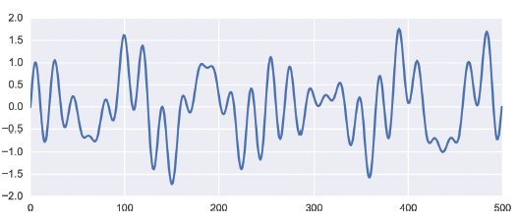
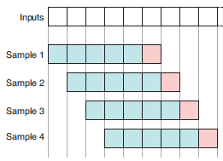
Sequence Data
Lets start with a synthetic dataset created by adding a bunch of sine waves together. The first 500 samples are shown. This is considered our Training Data Set.
To train our RNN, we take the first five values from our dataset and ask our little network to produce the sixth value.
Then we then take values 2 through 6 of the dataset and ask it to predict the seventh value.
We say that we’re using a sliding window to choose each set of inputs.

Slide 4
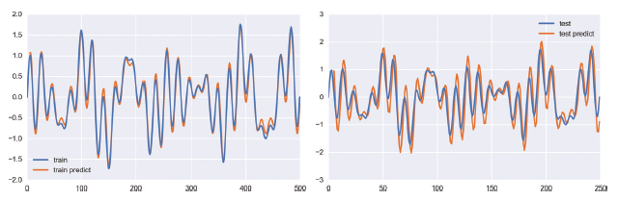
Sequence Data
From our starting 500 values, we can make 495 samples in this way. We trained our network on these samples for 50 epochs.
When we run the training data through again and ask for predictions, we get the results on showing the original training data in blue, and the predictions in orange. Not bad!

Slide 5
Novel prediction
One of the most complex sequential data is natual language
Let's try to learn how to generate language

Slide 6

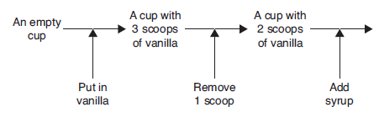
Recurrent Neural Networks - State
RNNs make use of an idea called state. This is just a description of a system (such as a neural network) at any given time.
Suppose that you’re working at an ice-cream shop and you’re learning how to make a simple fudge sundae.
In this story, you play the role of the system, and the recipe you’re building up in your head is your state.
Before getting any instructions, your starting state or initial state would be “An empty cup.”
https://www.flickr.com/photos/skrb/6376986365/in/photostream

Slide 7
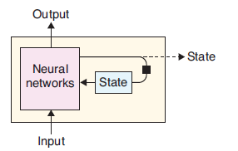
A few keys about the concept of state
There are a few key things to take away from this story and the concept of state.
First, your state is not simply a snapshot of the current situation or a list of the information you were given.
It captures both of those ideas, perhaps in a compressed or modified form.
For example, instead of remembering to put in three scoops of ice cream and then removing one, you remembered instead to put in two scoops.

Slide 8
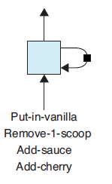
A few keys about the concept of state
Second, after receiving new information at each step, you updated your state and produced an output. The output depends on the input you received and your internal state,
An outside observer can’t see your state, and so they might not understand how your output resulted from the input you just received. We referring to a system’s state as its hidden state.
Finally, the order of the inputs matters. This is the essential aspect of this example that makes it about a sequence, rather than just a bunch of inputs, and thus distinguishes it from our simple, fully connected layer introduced earlier.
We call each input a time step.

Slide 9
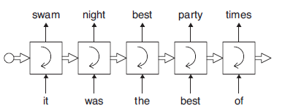
Recurrent Cells in Action
The first word, it, arrives. The cell considers the input and its hidden state, and predicts the next word, swam. We ignore
Now comes the second word from the text, was. Again, the cell consults its hidden state and the input, and produces a new output prediction, completing the phrase it was night
This goes on until we provide the fifth word, “of”.
A recurrent cell predicting words. The diagram is in unrolled form. Predictions come out of the top of the cell, whereas state is indicated by the thick horizontal arrow.

Slide 10
Recurrent Cells in Action
If we’re near the start of training, the system might produce something like jellyfish,
But after enough training on the original text, the networks inside the recurrent cell will have learned how to represent the consecutive words of the phrase “it was the best of” in such a way that the word “times” has a high probability.
A recurrent cell predicting words. The diagram is in unrolled form. Predictions come out of the top of the cell, whereas state is indicated by the thick horizontal arrow.

Slide 11
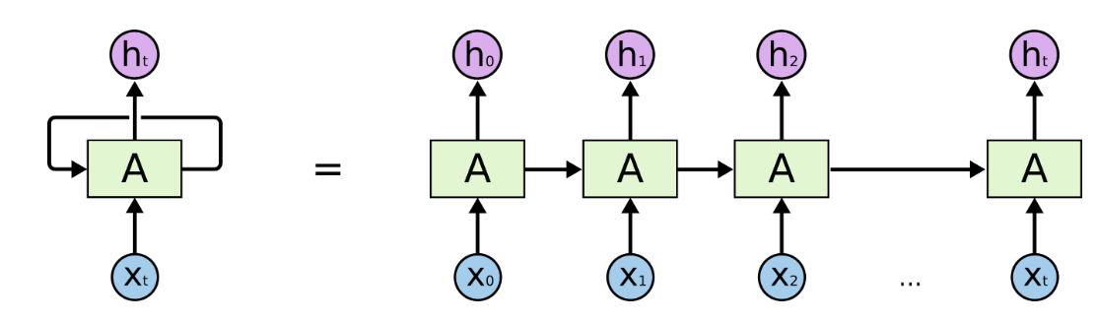
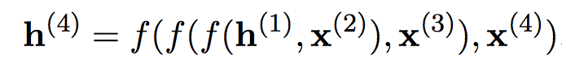
Recurrent neural networks: simple
For example

Slide 12
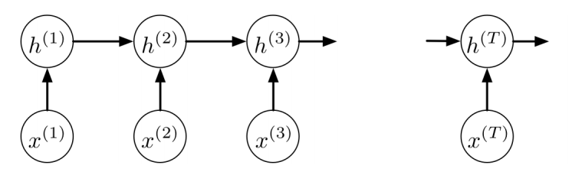
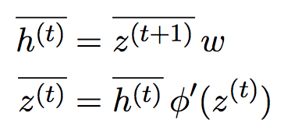
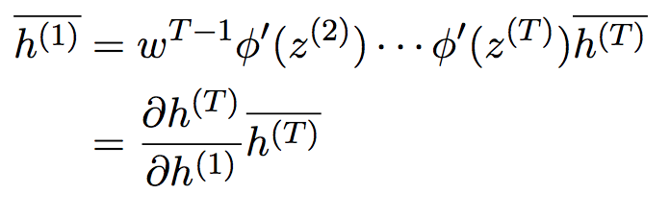
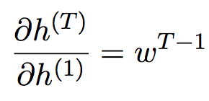
RNN: a problem with gradients
Image this:
We alternate between the following two equations:
Lets assume that activation is linear, then

Slide 13
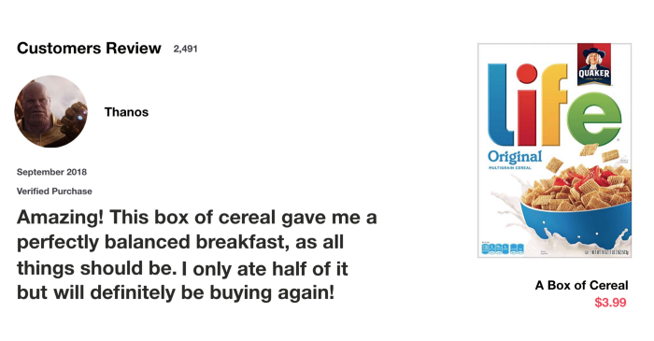
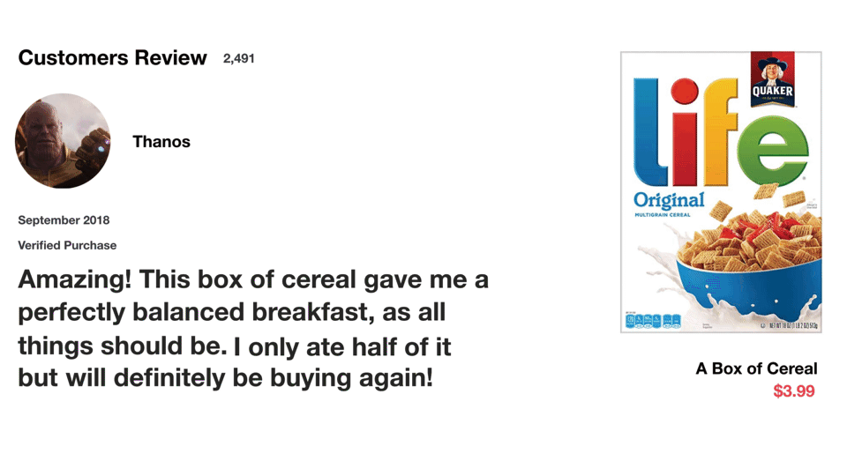
(L)ong (S)hort-(T)erm (M)emory
We can avoid the vanishing gradients with a fancier recurrent cell, called a long short-term memory, or LSTM.
The name can be confusing, but it refers to the fact that the internal state changes frequently, so it can be considered a short-term memory.
But sometimes we can choose to keep some information in the state for a long time.
Vanilla RNN
LSTM
It might be helpful to think of this as a selectively persistent short-term memory.

Slide 14
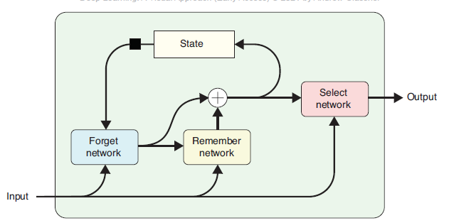
(L)ong (S)hort-(T)erm (M)emory
The LSTM uses three internal neural networks.
The first is used to remove (or forget) information from the state that is no longer needed.
The second inserts new information the cell wants to remember.
The third network presents a version of the internal state as the cell’s output.
We can place this LSTM cell on a layer and train the neural networks inside it using normal backpropagation and optimization.
When people speak of “an RNN” they often mean a network that
uses the LSTM in particular. A popular variation is the gated recurrent network, or GRU.

Slide 15
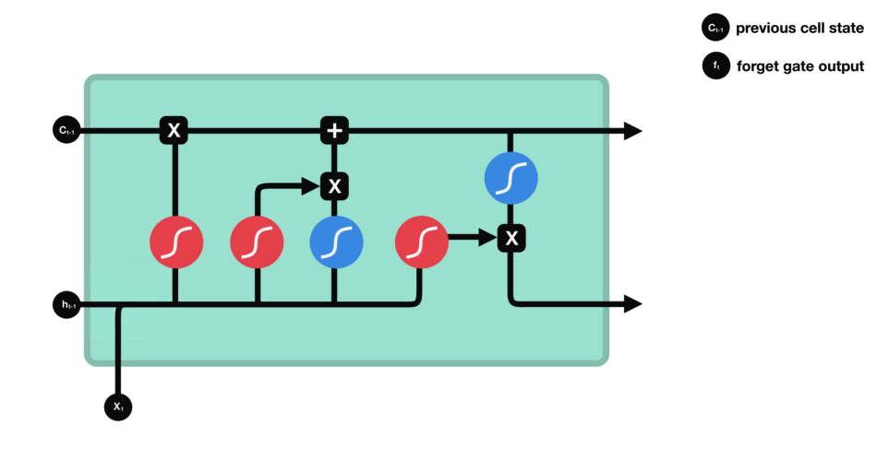
LSTM Walk Through
Forget gate layer: how much information from the previous time step will be kept?
This gate decides what information should be thrown away or kept.
Information from the previous hidden state and information from the current input is passed through the sigmoid function.
Values come out between 0 and 1. The closer to 0 means to forget, and the closer to 1 means to keep.
https://towardsdatascience.com/illustrated-guide-to-lstms-and-gru-s-a-step-by-step-explanation-44e9eb85bf21

Slide 16
LSTM Walk Through
Input gate layer: which values will be updated
To update the cell state, we have the input gate. First, we pass the previous hidden state and current input into a sigmoid function.
That decides which values will be updated by transforming the values. 0 means not important, and 1 means important.
You also pass the hidden state and current input into the tanh function to squish values between -1 and 1 to help regulate the network
https://towardsdatascience.com/illustrated-guide-to-lstms-and-gru-s-a-step-by-step-explanation-44e9eb85bf21

Slide 17
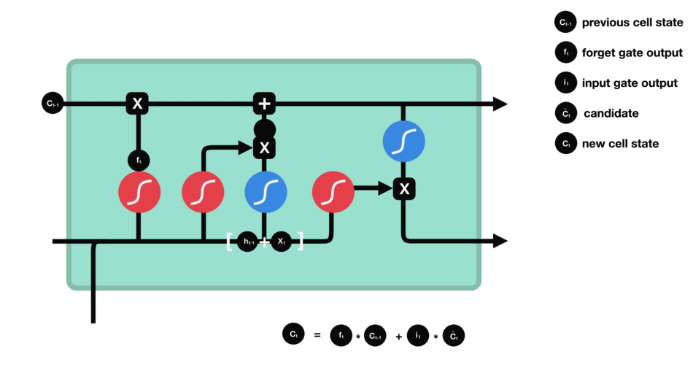
LSTM Walk Through
Cell state,
Now we should have enough information to calculate the cell state.
First, the cell state gets pointwise multiplied by the forget vector. This has a possibility of dropping values in the cell state if it gets multiplied by values near 0.
Then we take the output from the input gate and do a pointwise addition which updates the cell state to new values that the neural network finds relevant. That gives us our new cell state.
https://towardsdatascience.com/illustrated-guide-to-lstms-and-gru-s-a-step-by-step-explanation-44e9eb85bf21

Slide 18

LSTM Walk Through
Output Gate - Based on the cell state, we will decide what the output will be
Last, we have the output gate. The output gate decides what the next hidden state should be.
Remember that the hidden state contains information on previous inputs. The hidden state is also used for predictions.
The output is the hidden state. The new cell state and the new hidden is then carried over to the next time step.
https://towardsdatascience.com/illustrated-guide-to-lstms-and-gru-s-a-step-by-step-explanation-44e9eb85bf21

Slide 19
LSTM details
Parameters: 4 sets of
- W matrix: (input + 1)*(memory size)
- U matrix: (memory size)*(memory size)
The "+1" is due to bias term
From https://cs224d.stanford.edu/lecture_notes/LectureNotes4.pdf

Slide 20
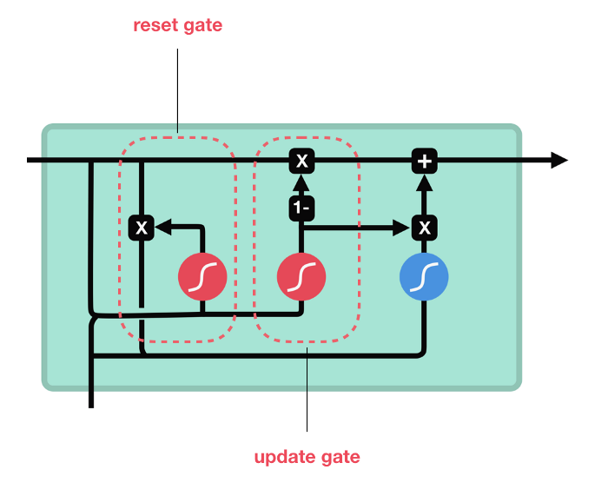
Gated Recurrent Unit
The GRU is the newer generation of Recurrent Neural networks and is pretty similar to an LSTM.
GRU’s got rid of the cell state and used the hidden state to transfer information. It also only has two gates, a reset gate and update gate.
Update Gate
The update gate acts similar to the forget and input gate of an LSTM. It decides what information to throw away and what new information to add.
Reset Gate
The reset gate is another gate is used to decide how much past information to forget.
https://towardsdatascience.com/illustrated-guide-to-lstms-and-gru-s-a-step-by-step-explanation-44e9eb85bf21

Slide 21
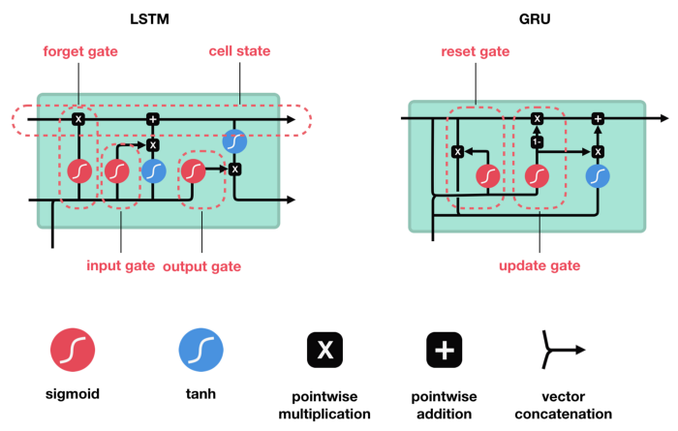
GRU Vs. LSTM
GRU’s has fewer tensor operations; therefore, they are a little speedier to train then LSTM’s. There isn’t a clear winner which one is better. Researchers and engineers usually try both to determine which one works better for their use case.
https://towardsdatascience.com/illustrated-guide-to-lstms-and-gru-s-a-step-by-step-explanation-44e9eb85bf21

Slide 22
Example
Generate text based on characters
40 input characters of 56 possiblities
Two 128 LSTM units
Prediction of 56 "next character"
56
56
softmax

Slide 23
Activity
https://colab.research.google.com/github/daniel-acuna/applied_deep_learning/blob/master/RNN/lstm_character_level_text_generation.ipynb
Activity #1: Number of parameters?
Activity #2: "What is the meaning of life?"

Slide 24
More advanced examples
http://karpathy.github.io/2015/05/21/rnn-effectiveness/

Slide 25
Deep RNN

Slide 26
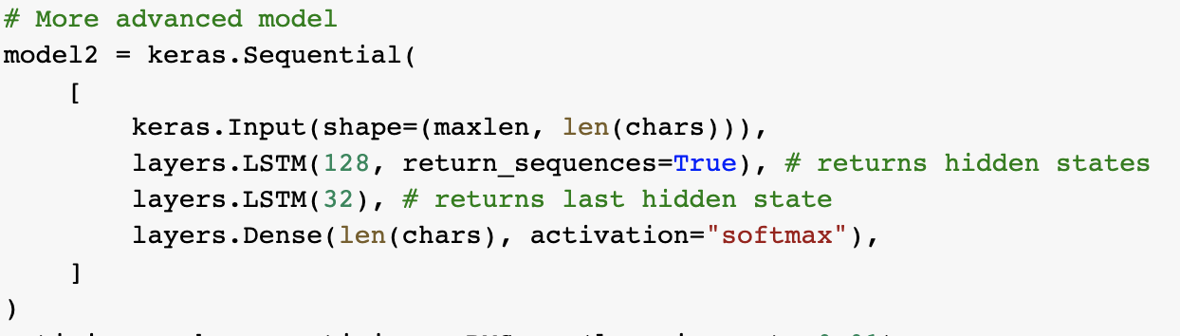
Careful
Keras' LSTM unit returns last hidden state by default.
When building multiple LSTM, you want the previous LSTM states to be the inputs of the next one

Slide 27
Bidirectional RNN
"I saw the man on the hill in Texas with the telescope at noon on Monday,”

Slide 28
Seq2seq

Slide 29

Many other possibilities
Credit: http://karpathy.github.io/2015/05/21/rnn-effectiveness/

Slide 30
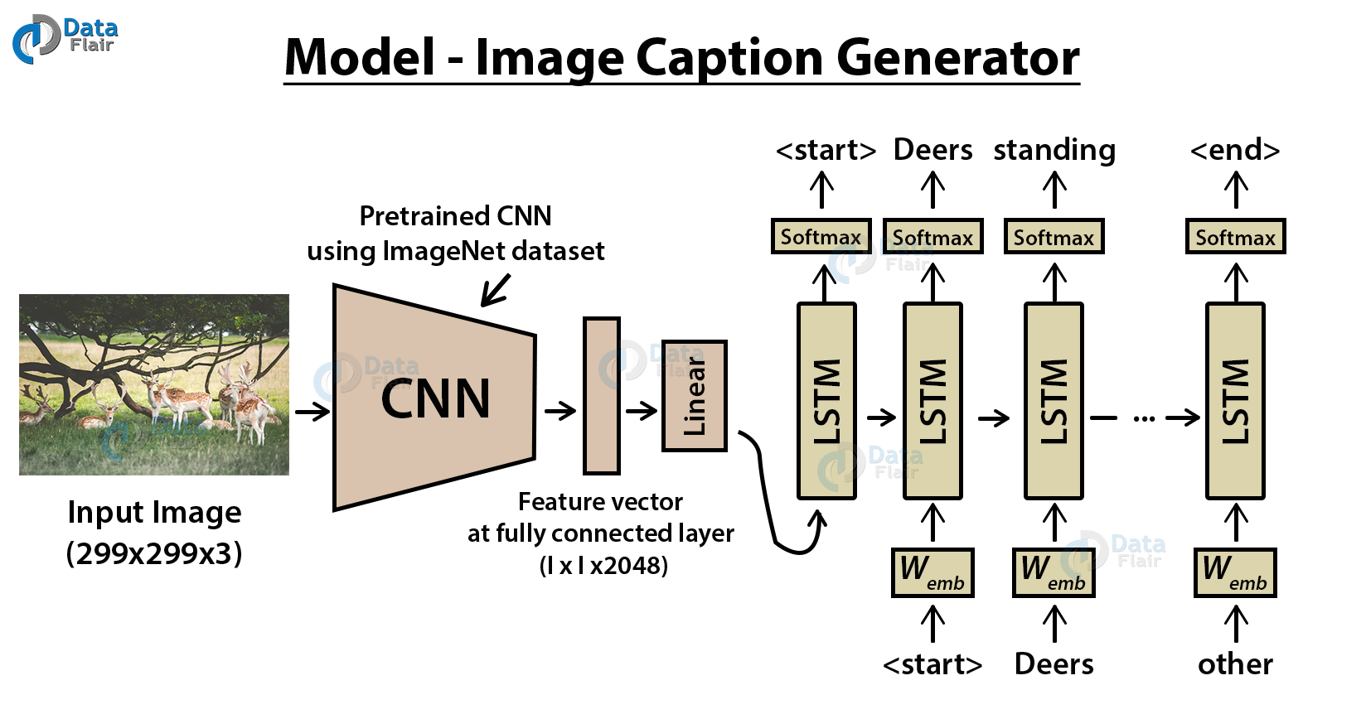
Combinations
Credit: https://data-flair.training/blogs/python-based-project-image-caption-generator-cnn/

Slide 31
Limitations of RNN
Recurrent neural networks work in sequence: you have to wait to generate the data
Compared to CNNs, this can be very slow
New architectures try to predict the entire sequences at once
The next generation of methods is based on attention

